Slide 1
COSC 6370 – ADVANCED SOFTWARE ENGINEERING
BlinkID
04/22/2024
Project Smart Campus
Varun Vanaparthi | Software Project Manager
Venkata Sai Ramya Padmasri Boggaram | Software Project Technical Manager
Mounika Reddy Dubba | Software Project Quality Assurance and Configuration Manager
Himaadithi Lethakula | Software Project Requirements Manager
Vyshnavi Balabhadruni | Software Project Design Manager
Akash Rao Sudati | Software Configuration Manager
Sai Charan Kammampally | Software Developer
Sriharsha Lanka | Software Developer
Chethan Reddy Mallu | Software Developer
Shiva Kumar Goud Shankaragari | Software Test Engineer
Dheeraj Chigurupati | Software Test Engineer
Ritheesh Reddy Gavva | Software Developer

Slide 2
Presentation Outline
Project Vision
Project Planning
Project Requirements
Product Design
Project Implementation
Product Testing
Lessons Learned
Product Features
Product Launch

Slide 3
Project Vision
Problem:
Addressing illegal access and identity fraud in academic institutions is crucial for maintaining security and integrity.
Affected Parties:
Students, staff, administrators, and individuals in academic institutions.
Impact:
Compromised safety
Potential financial losses
Diminished trust in security measures

Slide 4
Project Vision
Desired Solution:
“BLINK OF AN EYE”
Reliable and rapid identification
Privacy assurance
Fosters a secure environment for all stakeholders
Stakeholders:
Academic Staff
Students
Administrative Personnel

Slide 5
Project Vision
Strengths:
Security Measures
Ease of Use
Scalability
Reasons to Buy or Use:
Enhanced Security
Efficient Examination Process
Improved Access Control

Slide 6
Project Planning
Mode of Interactions:
Trello
Whatsapp
Zoom
Risks to Consider:
Privacy concerns
Data security
Technological Limitations
Resistance to Acceptance

Slide 7
Product Requirements
Uses Cases:
University Management
Make Registration
Creating Exams
Enroll Students to Exams
Validate Students in Exams
Creating Groups
Enroll Students to Groups
Validate Students in Groups

Slide 8
Product Requirements
Functional Requirements:
Enhance campus security.
Include a visible camera.
Require a stable internet connection.
Non-Functional Requirements:
Maintain a simple architecture.
Ensure security against unauthorized access.
Enable easy maintenance with secured user data.
Ensure reliability and availability at all times.

Slide 9
Product Design
Main Design Decisions and Constraints:
Mobile Platform: Android
Programming Language: Kotlin and Java
User Interface Design: Teacher, Staff, Student
Data Design: Performance and scalability
API Integration: Spring Boot and Flask APIs
Security: Encryption and secure authentication.
Mobile Optimization: Responsive design for optimal mobile experience.

Slide 10
Project Design
Software Design:
Modules
Data Storage
API Integration
User Interface Design:
Login/Register Screen
Main Dashboard
Task Management Interface
Group Management Interface
Authentication Screen

Slide 11
Project Implementation
Approach for Product Implementation:
API – Spring boot micro service
Face Recognition – Flask API
Image store – Aws, Firebase storage
Android – Kotlin
Web - ReactJs
Deployment – Github actions
Hosting – Aws EC2, Elastico, Bean stalk
Teamwork during Product Implementation:
Communication
Task Allocation
Collaboration Tools
Code Reviews
Feedback and Iteration

Slide 12
Product Testing
Test Environment: Android phone with the latest OS installed.
Application Installation: The application is installed on the phone.
Testing Location: Controlled environment to avoid external interferences.
Internet Connection: Available for testing online features.
Most Important Test Cases:
User Registration
Biometric Data Enrollment
Task Creation
Authentication
Data Security

Slide 13
Lessons Learned
Most challenging aspect :
Integrating all the components
Working with new technologies
Coordination and collaboration
Motivating Factors:
Potential impact on campus security and examination processes.
Demotivating Factors:
Technical challenges, setbacks.

Slide 14
Lessons Learned
Changes for Improvement:
Updating app constantly
Code reviews
Feedback loops
Improved UI
Successes:
Successful integration of facial recognition
Robust security measures

Slide 15
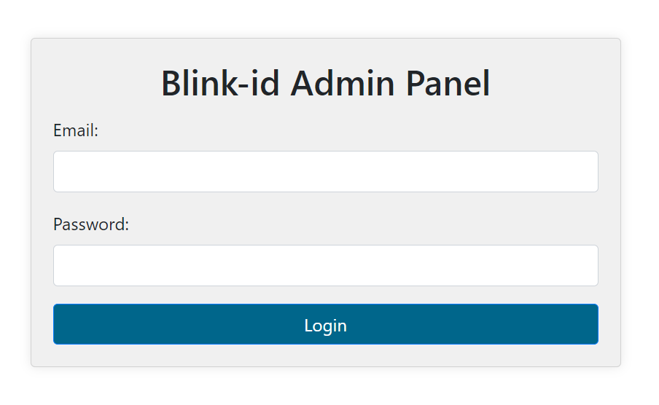
Product Features
Admin Login

Slide 16
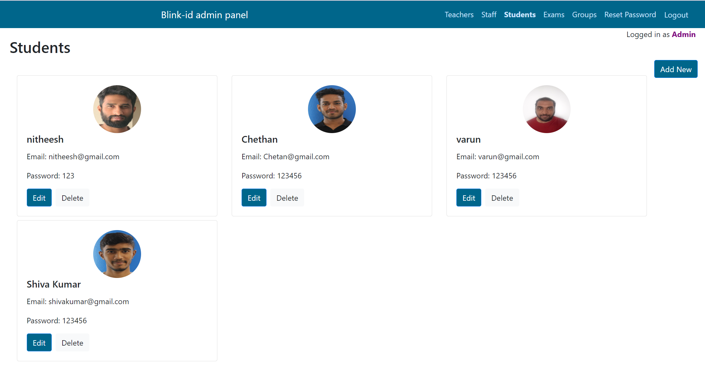
Product Features
Admin Panel

Slide 17
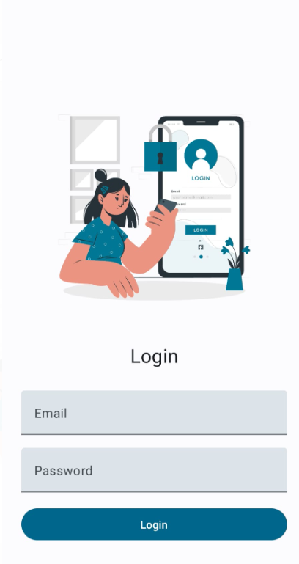
Product Features
Login Page

Slide 18
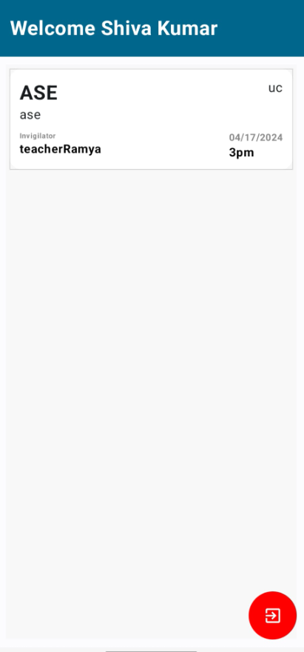
Product Features
Student
Dashboard

Slide 19
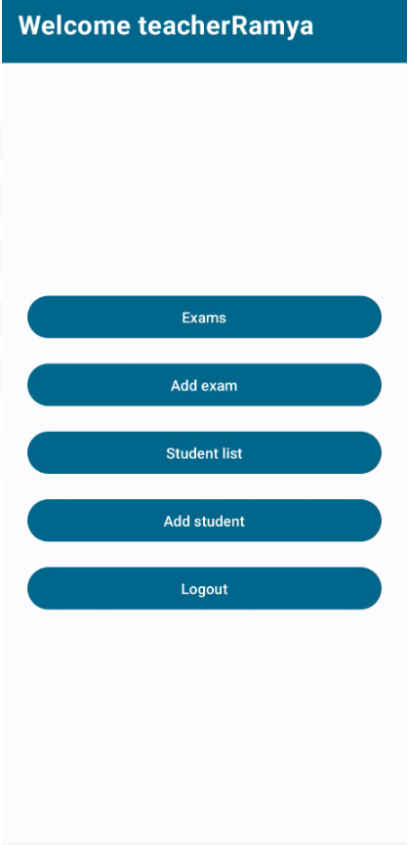
Product Features
Teacher
Dashboard

Slide 20
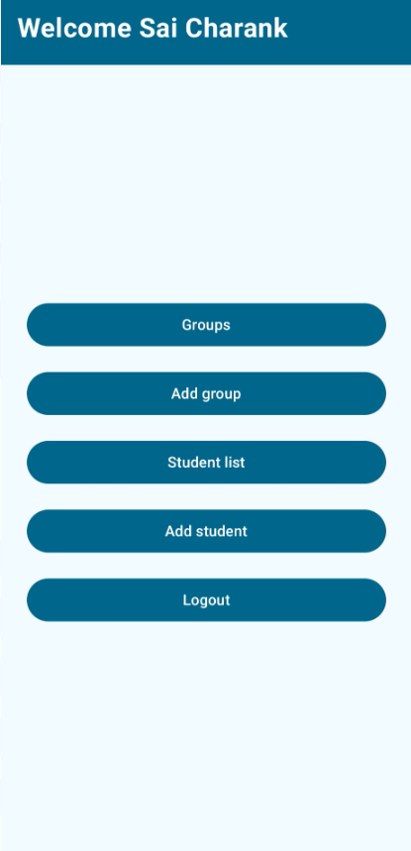
Product Features
Staff
Dashboard

Slide 21

Product Launch
BlinkID

Slide 22
Thank You!

